Slide 1
Hocus Focus
The Science of Star Measurement for
Auto-Focusing and Tilt Correction
George Hilios
NEAIC, Suffern NY
April 14, 2023

Slide 2
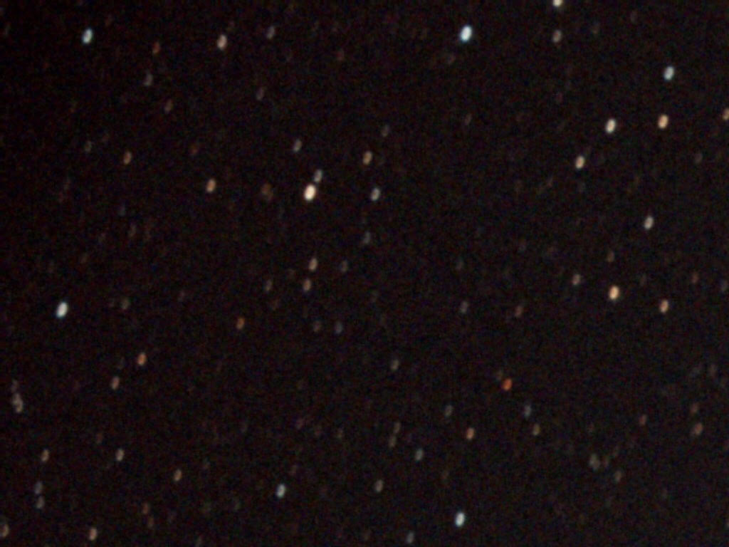
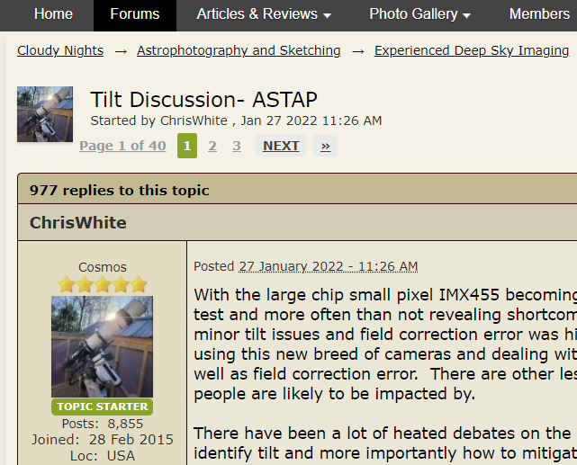
Familiar Situation?

Slide 3
Hocus Focus
Optimize performance for amateur astronomy
  Pinpoint focus
  Fast: Minimize image acquisition impact
  Sophisticated: Fine tune back-focus and tilt
Promote scientific discourse and discovery
  No ivory towers: test theories with data
Transparent algorithms
  No magic parameters!
  Fully open source (MPLv2)

Slide 4






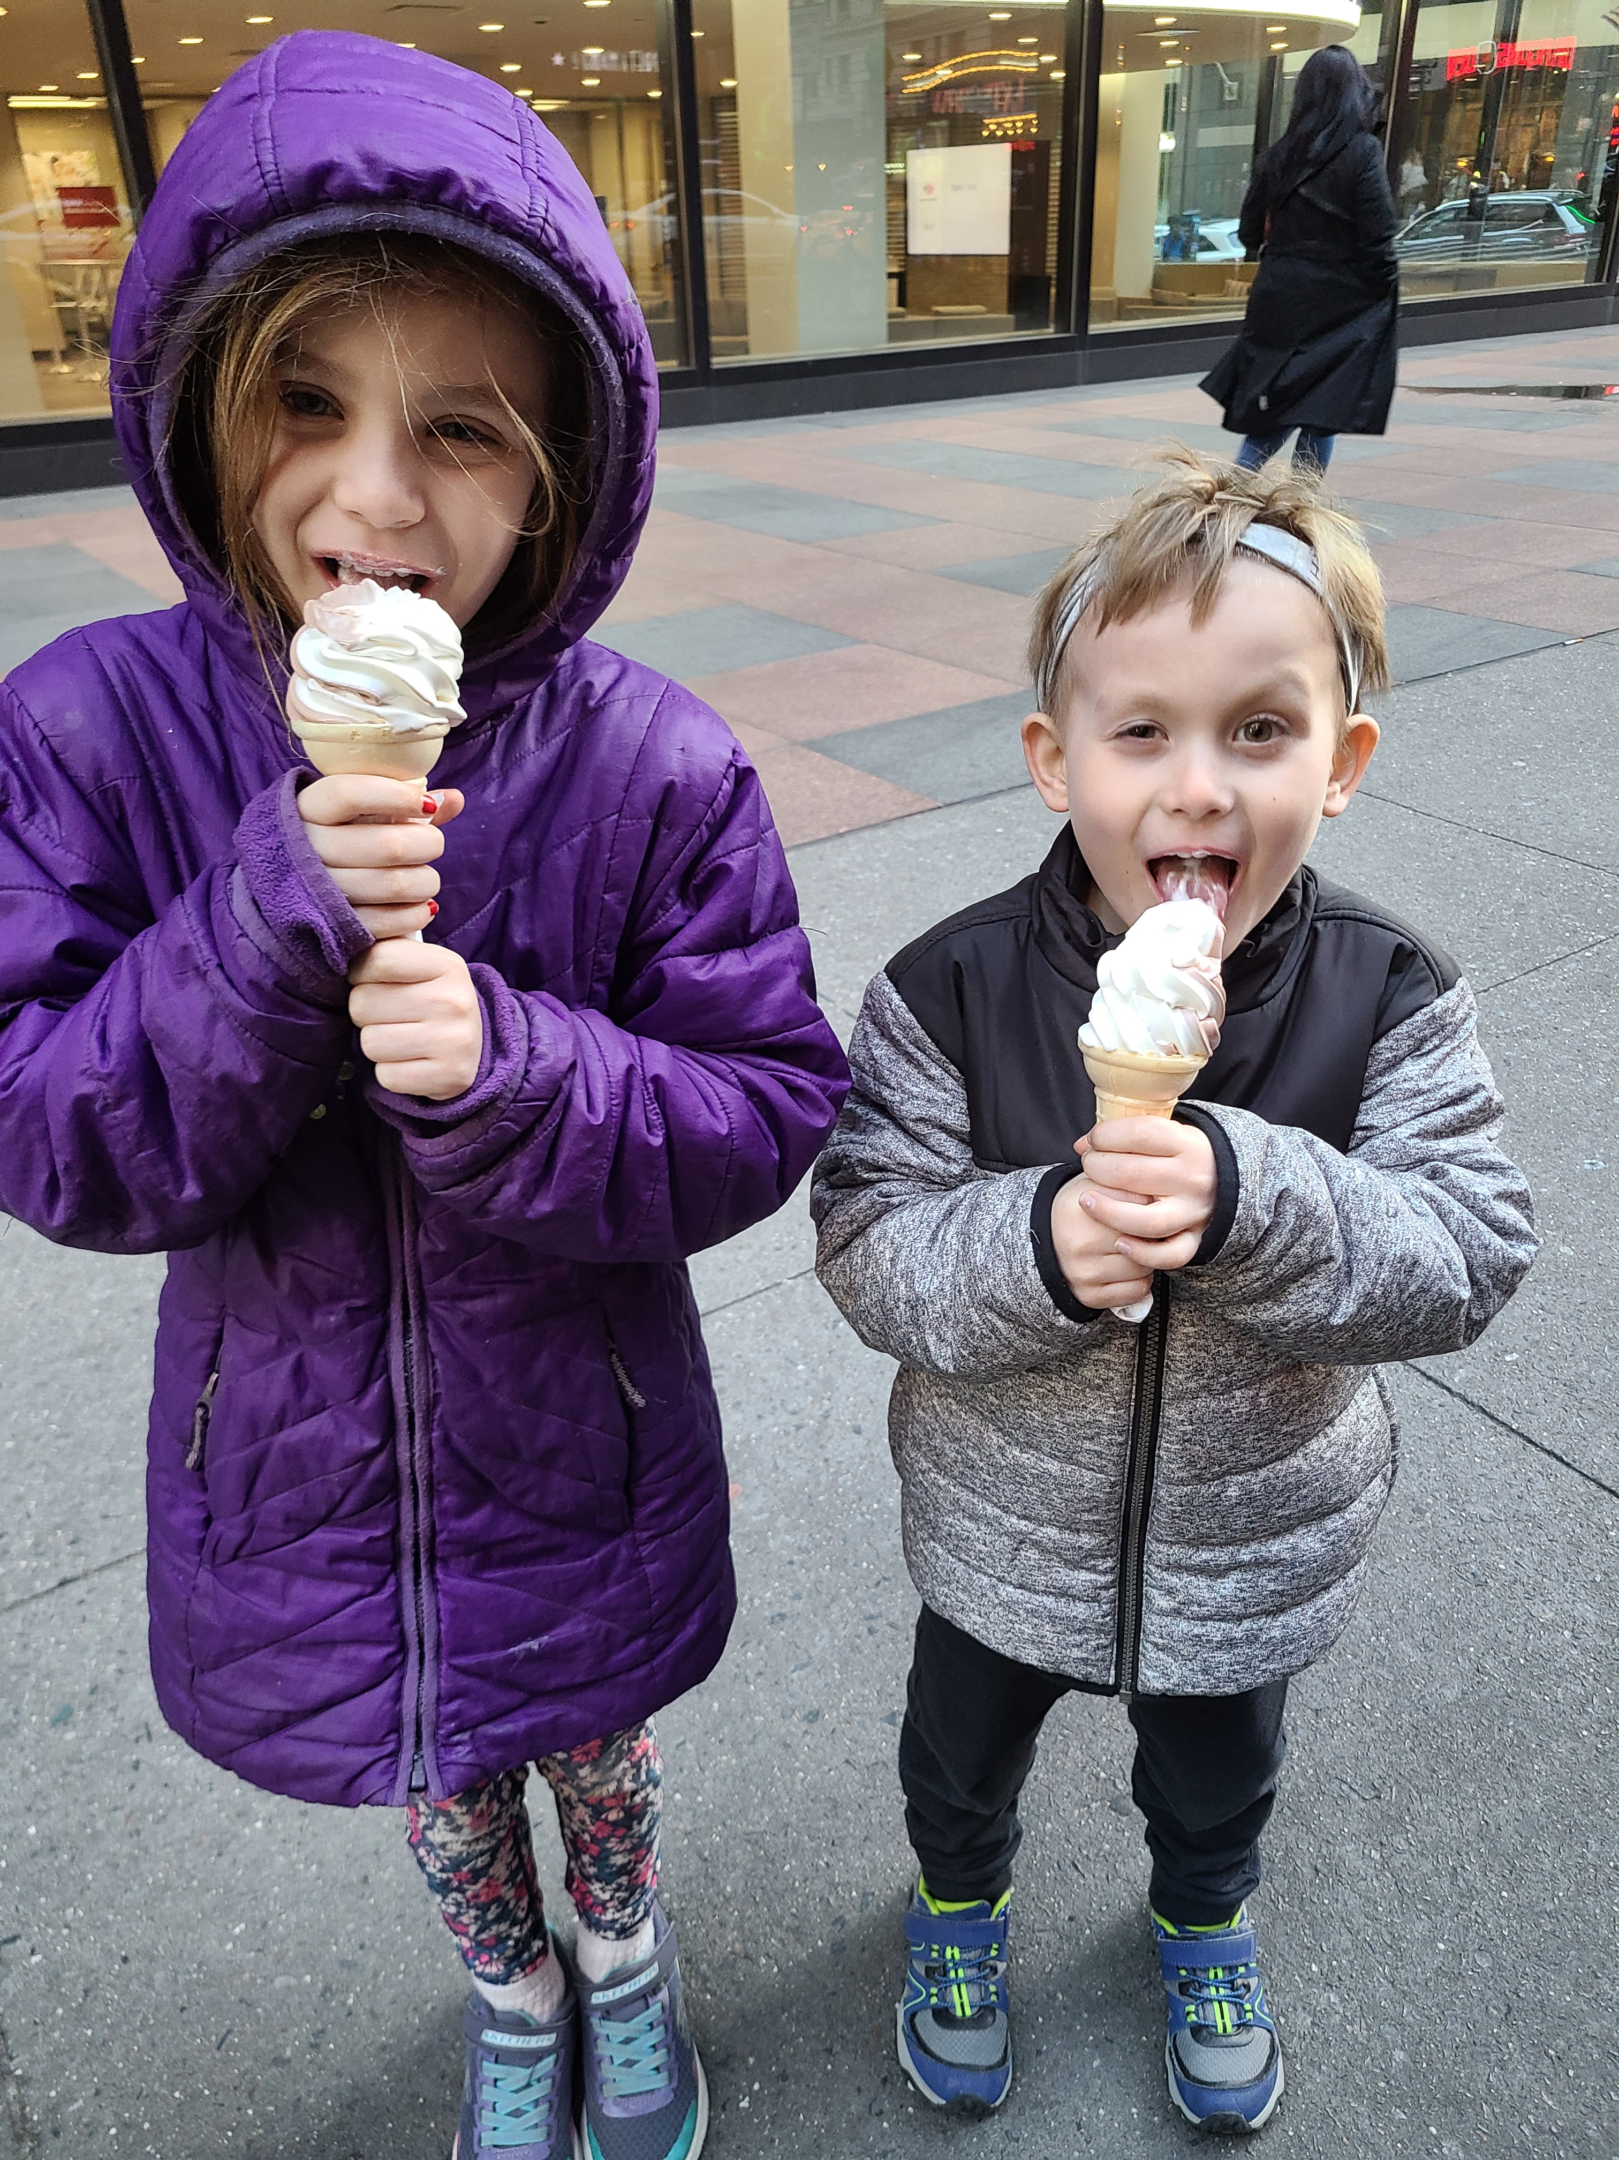

About Myself

Slide 5
NINA Contributions
Dome support, including scope synchronization
Center after Drift
MetaGuide integration
SBIG CCD native support
Plugins
  Orbitals: tracking and imaging comets, asteroids, planets
  10u Tools: building models for 10 micron mounts
  Hocus Focus: Auto focus, PSF measurement, aberration inspection

Slide 6
Agenda
Scientific Workbench
Star Measurement
Finding Optimal Focus
Tilt and Backfocus
Future Work

Slide 7
Scientific Workbench
Collect the right tools to iterate on new methods

Slide 8

View measurements per star
No magic knobs, all parameters configurable
Re-analyze with different approaches
Visual inspection of each step of the process

Slide 9
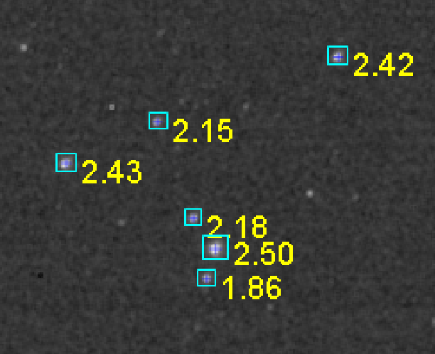
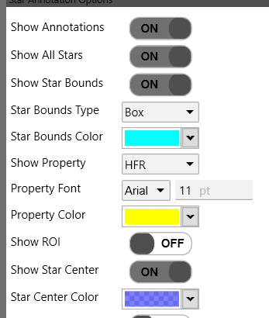
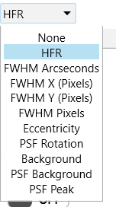
Star Annotation

Slide 10
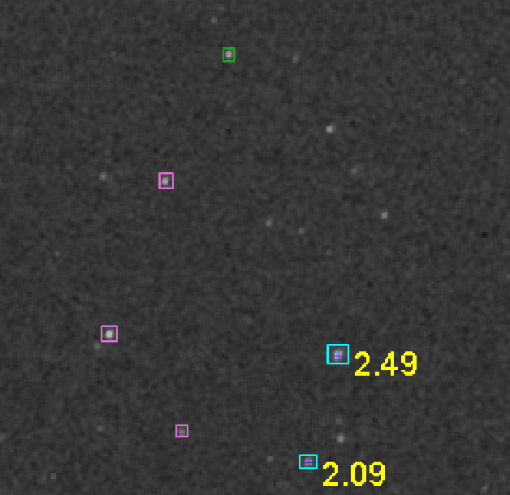
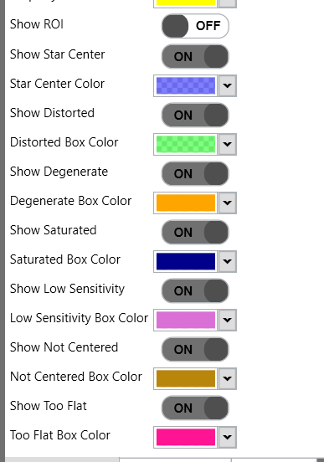
Star Rejection

Slide 11
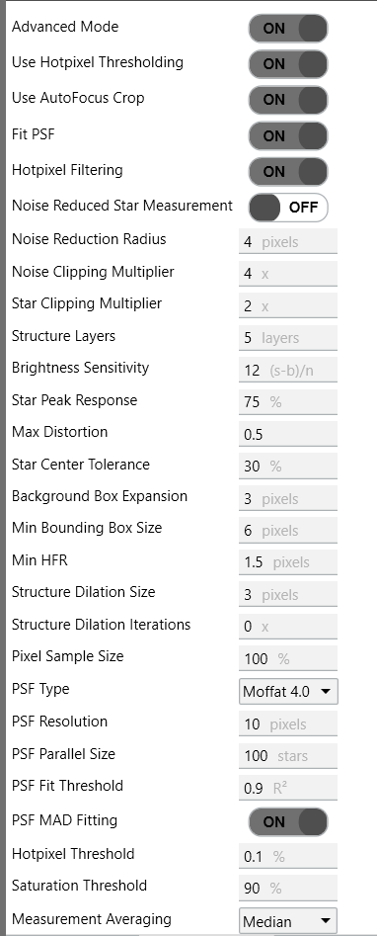
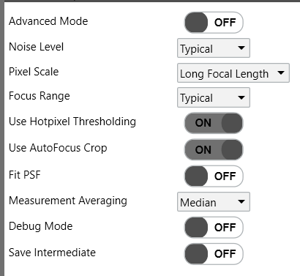
Tunable Parameters

Slide 12
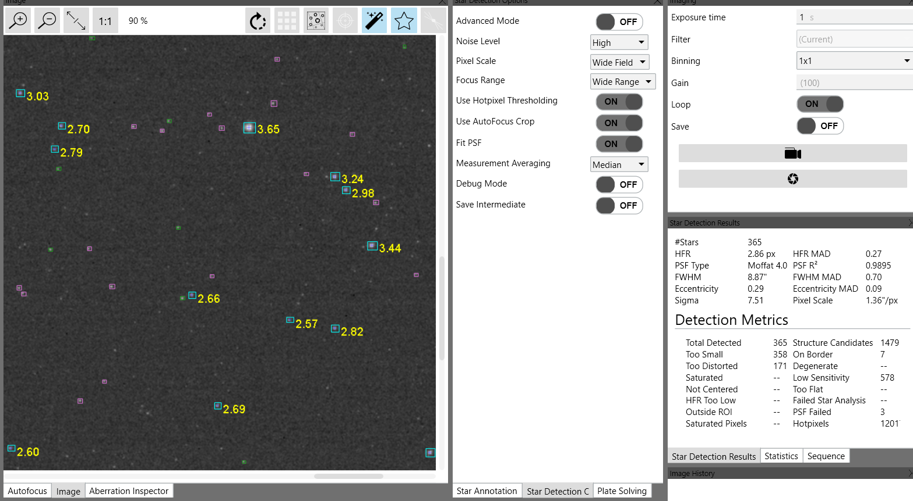
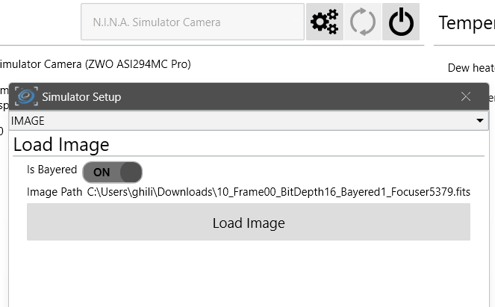
Test and Iterate

Slide 13
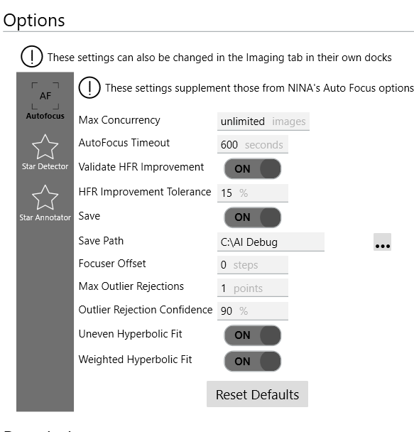
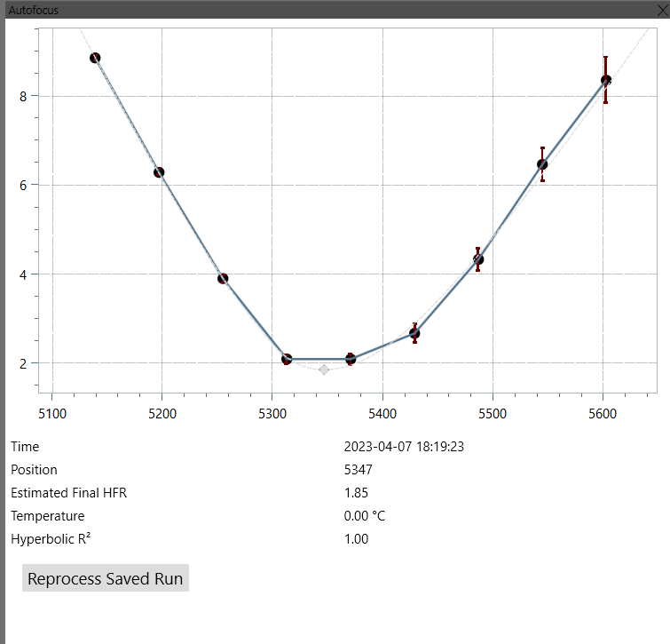
Autofocus Replay

Slide 14
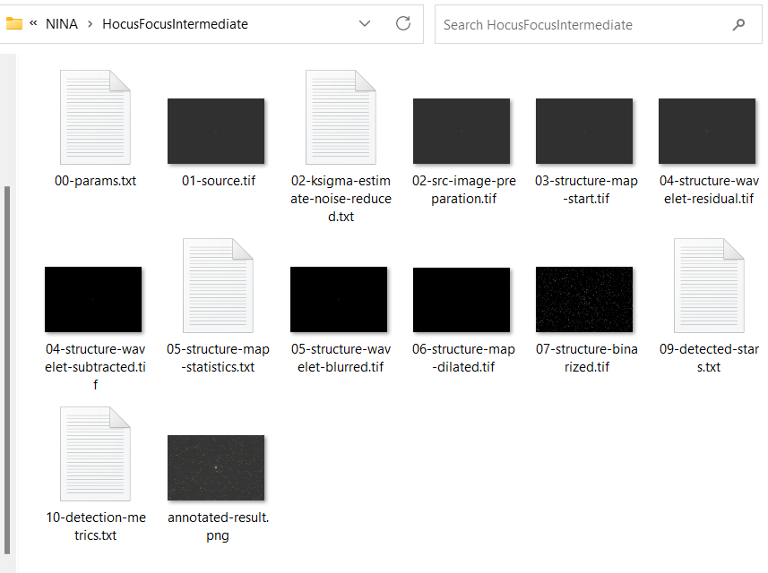
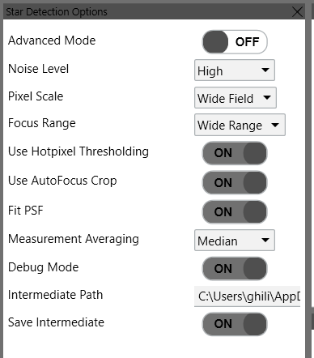
Development Debugging

Slide 15
Measuring Stars
Size, Shape, Center Position, etc

Slide 16
Goals
Identify star candidates
Reject low-quality or poor matches
  Double stars
  Distorted
  Flat discs
Measure heuristic for star focus
  FWHM or HFR?

Slide 17
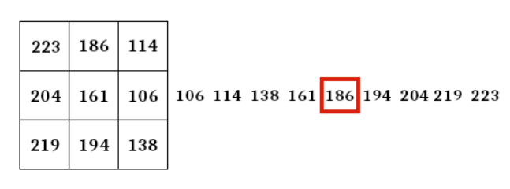
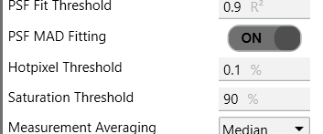
1 – Hotpixel Filtering
Simple (low-overhead) – 3x3 Median Blur
Thresholding (preferred) – Filter when large diff

Slide 18
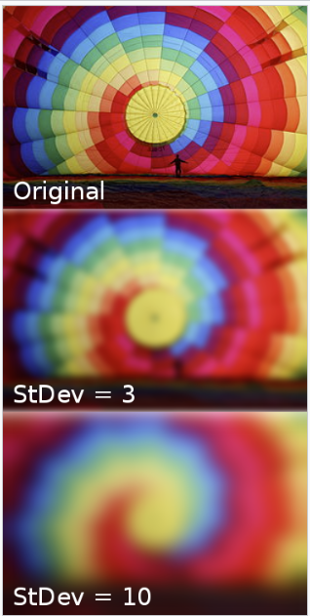

2 – Noise Reduction
Gaussian Convolution
Stdev = Radius * 2 + 1

Slide 19



3 – Structure Detection
Wavelet to extract structures
Larger = bigger stars = longer focal length
Kappa Sigma background noise estimate
Larger = higher background noise
Dilate star candidate structures
Off by default
Binarize
Noise Clipping Multiplier * noise estimate
Star candidate boxes

Slide 20





4 - Rejection
Has saturated pixels
Touching border of image
Elongated/Distorted
Too dim
Centroid not centered
Too flat/no peak

Slide 21
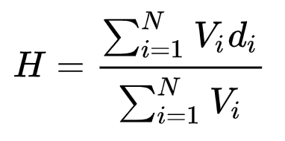
5 – HFR Measurement
Sum of pixel brightness * center distance
Sum of pixel brightness
Distance containing half of star brightness

Slide 22
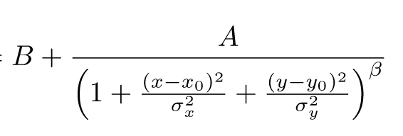

6 – FWHM Measurement
Point Spread Function
Non-linear optimization. No direct solution
B = background ADU
A = center ADU
x0, y0 = center
β = Moffat Beta (1.4)
σx, σy = FWHM sigma (solving for)
Convert sigma to FWHM pixels

Slide 23
Autofocus
Finding Optimal Focus

Slide 24
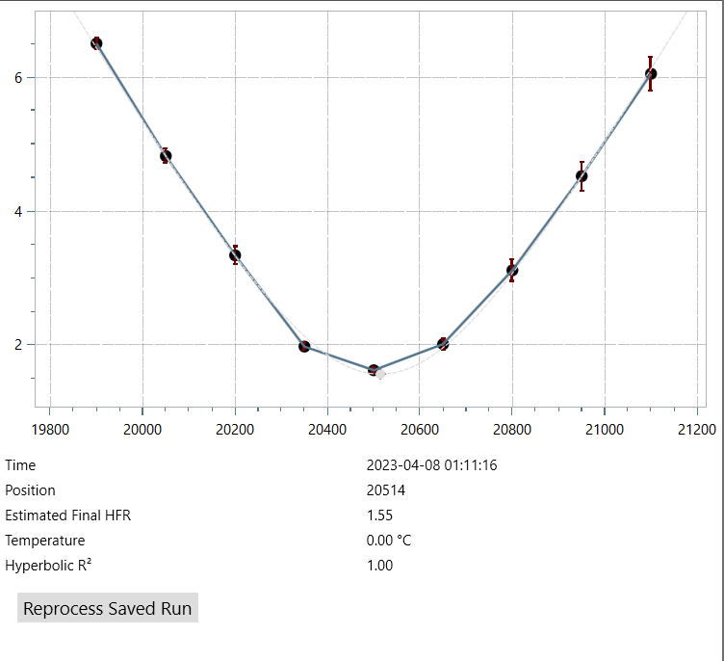

Hyperbolic Fit
HFR Std Dev
Minima
Goodness of Fit

Slide 25
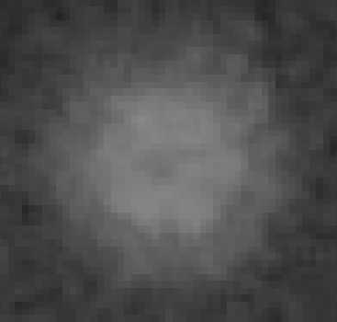
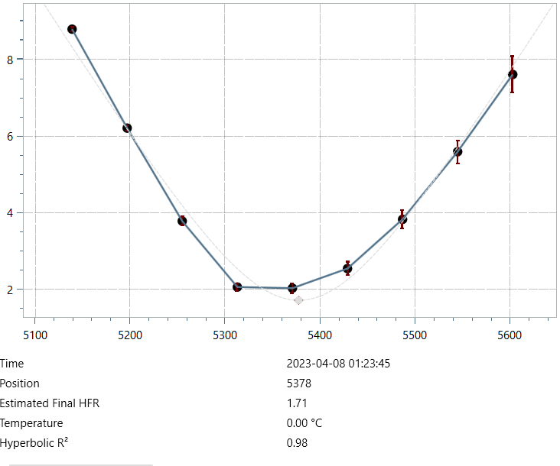
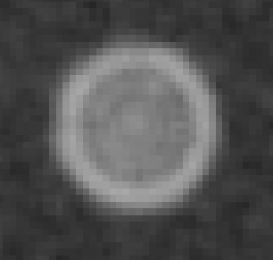
Doesn’t fit?

Slide 26
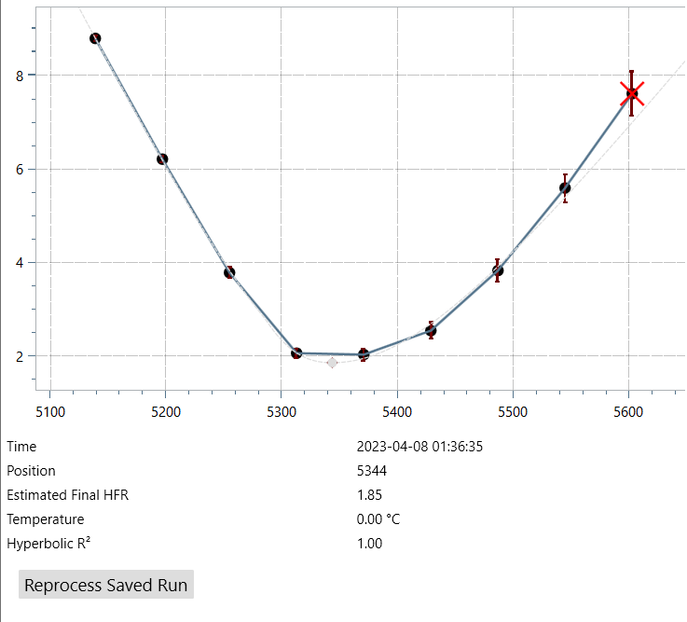
Improvements
Outlier rejection
Hyperbola with different slopes
Higher error = lower weight
Minima changed by 34 steps

Slide 27
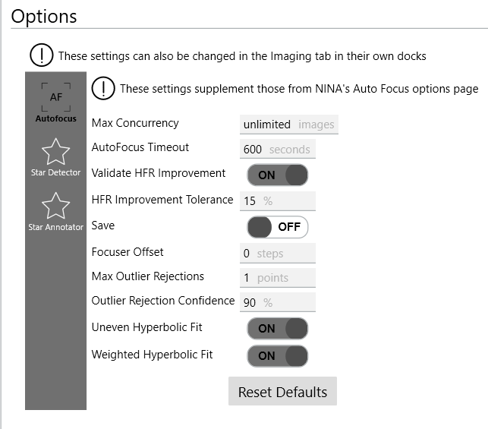
Options

Slide 28
Aberration Inspection
Measuring and correcting tilt and back-focus

Slide 29
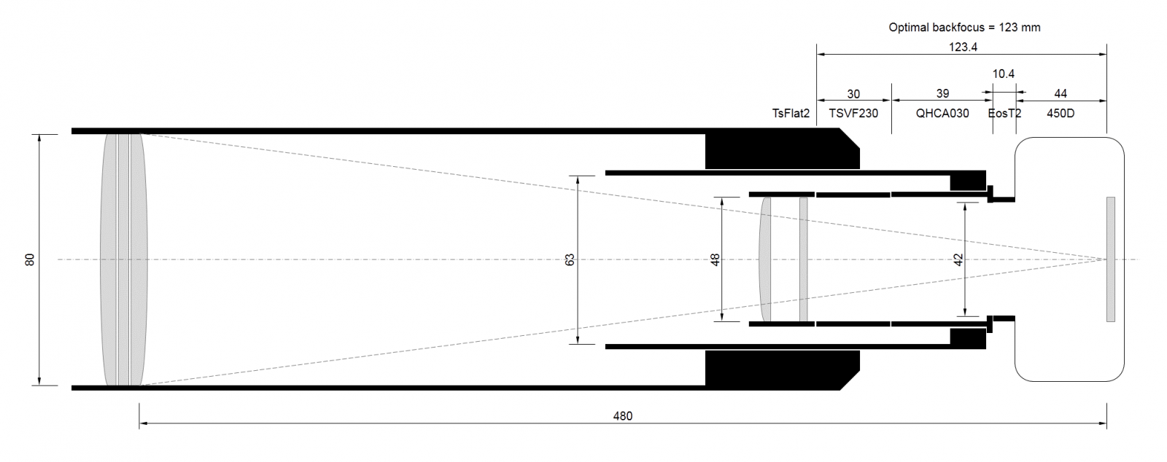
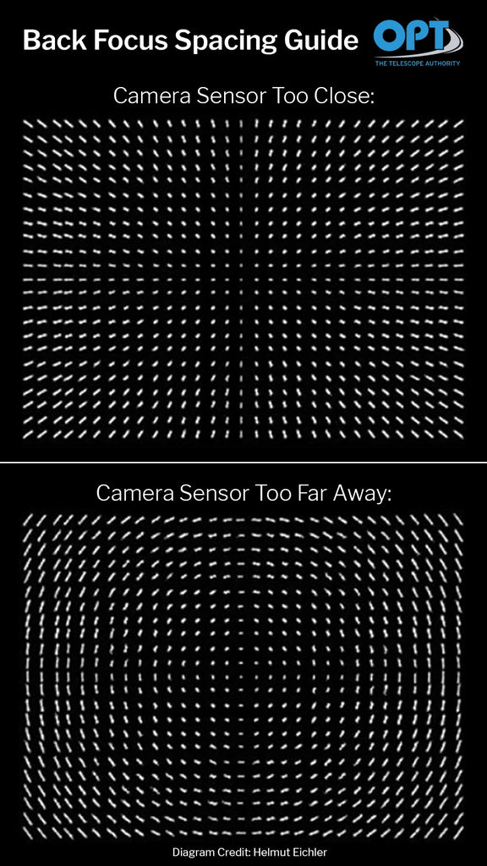
Background
Back-focus
Tilt
Similar, but at a gradient

Slide 30
Corners Analysis
Credit: Chris White
Cloudy Nights Thread - https://www.cloudynights.com/topic/809050-tilt-discussion-astap/
Divide sensor into grid (3x3)
Calculate optimal focus in center and corners
No tilt = corners arrive at focus together
Perfect backfocus = corners arrive at focus with center

Slide 31
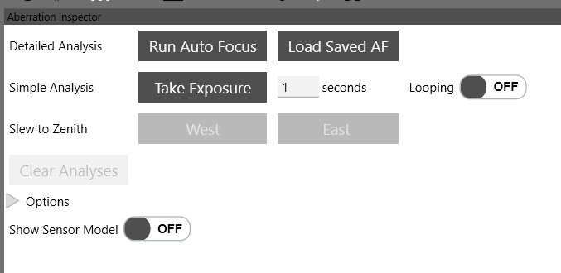
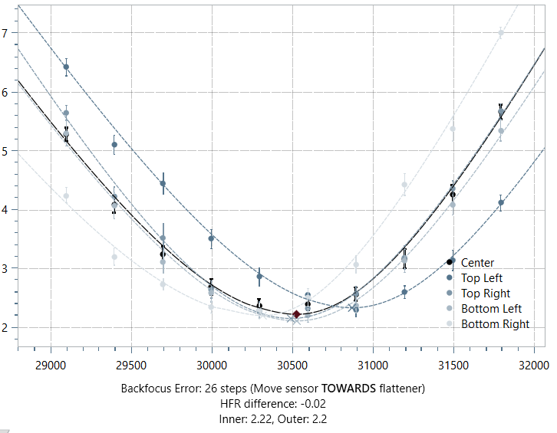
Automated in NINA
Replay or run live
Large tilt!
Tilt and back-focus mixed together…

Slide 32
Sensor Model
Credit: Frank Freestar8n
Observations
Corners model coarse due to averaging across regions
Tilt must be corrected to measure back-focus error
Approach
Calculate focus position for every star
Fit a 3d paraboloid across the sensor
Include a tilt plane to calculate both at the same time

Slide 33





Mathematical Model
Variables
x_{0,} y₀ Sensor Center
c Positive or negative curvature inverse radius. Smaller = flatter
Θ, Φ Tilt plane rotation, amount (radians). Θ = 0 = no tilt
Distance from sensor center
Offset from curvature
Offset from tilt
Total offset

Slide 34
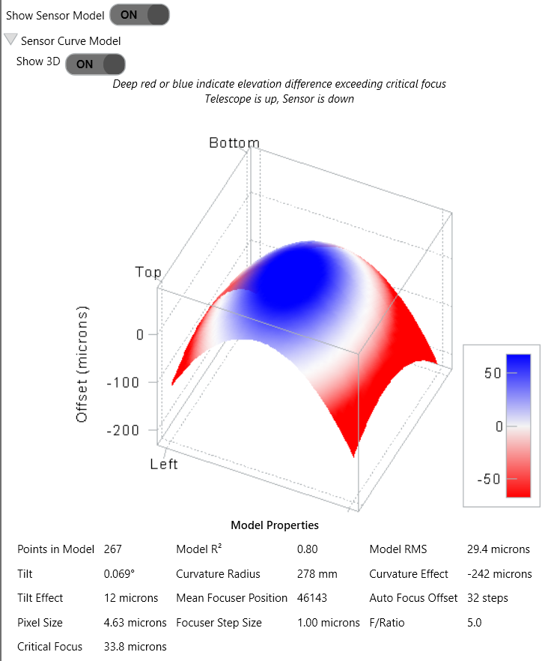
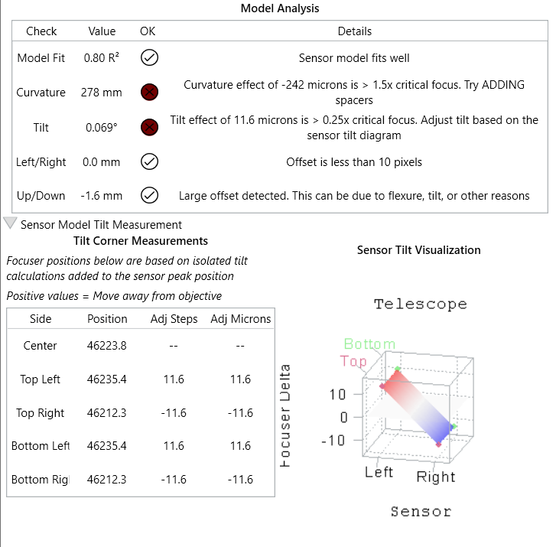

Slide 35
Techniques Applied
Non-linear optimization - Levenberg-Marquardt
  Implemented with Alglib
Naïve star registration – Quad Trees
  Use RANSAC instead
Deal with outliers – Iterative reweighting (IRLS)

Slide 36
Future Work

Slide 37
Future Work
Autofocus
Aberration Inspection
Fourier transformation method
  Credit: Cheng-Yan Tang
2-pass AF with FWHM and small step-size
Planetary AF in Fourier domain
Guidance for which screws to turn
  Calculate tilt adjuster screw locations
  Motorized tilt adjusters?
Evaluate interpolation instead of outlier rejection
  Ie, Kriging and RBF

Slide 38




Thank you
George Hilios
jokogeo (Discord)
ghilios (Cloudy Nights)

